Slide 1
«SoftLab-NSK» Irina Travina, CEO trav@sl.iae.nsk.su www.softlab-nsk.com
1
Notes:
1

Slide 2
JSC "SoftLab-NSK"
About
Created in 1991 and reorganized as JSC in 1997
Private company, 12 shareholders
About 80 employees
Areas:
Development, implementation and manufacturing of software and software/hardware systems for VR, simulation, multimedia, computer games.
www.softlab-nsk.com

Slide 3
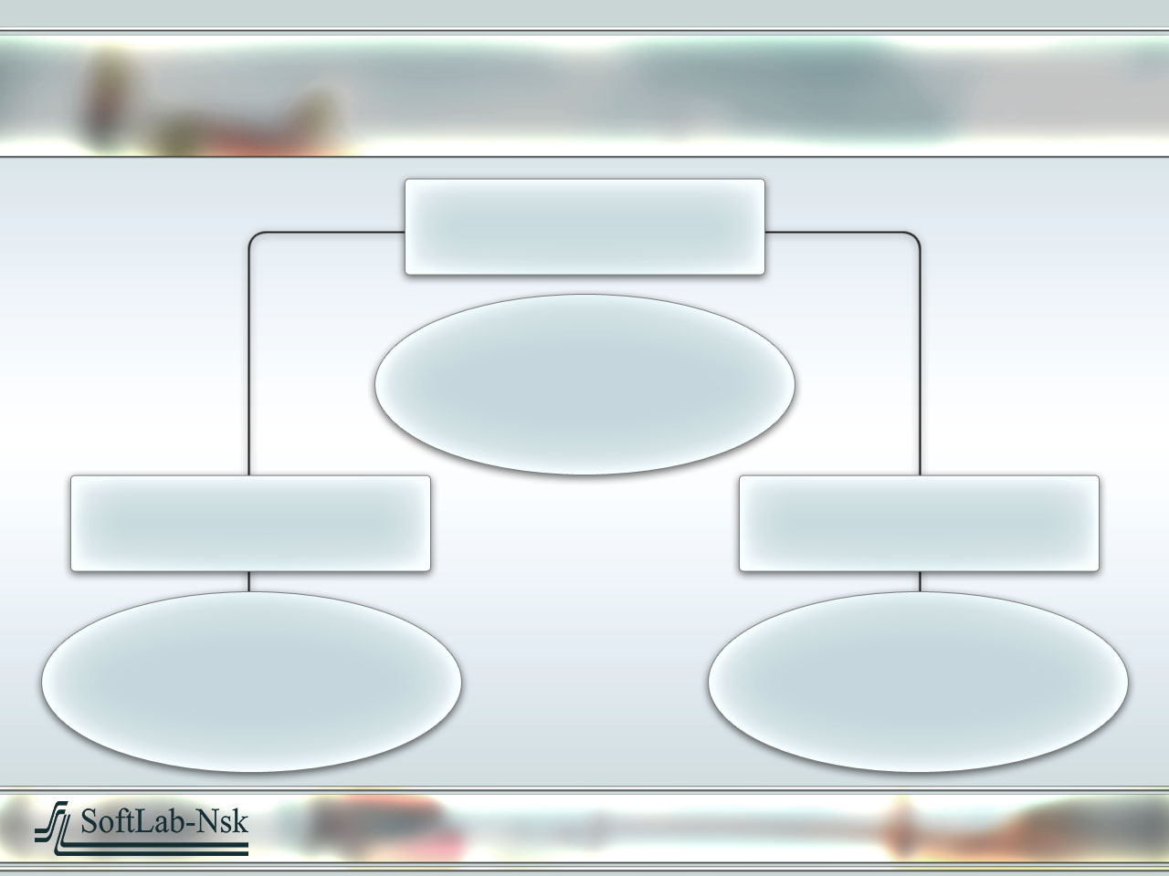
JSC "SoftLab-NSK"
General Director
Head office
Head of department
Head of department
Virtual Reality
department
Multimedia department
www.softlab-nsk.com

Slide 4
JSC "SoftLab-NSK"
Vasily Bartosh,
Head of Virtual Reality department vas@sl.iae.nsk.su www.softlab-nsk.com
www.softlab-nsk.com

Slide 5
Virtual Reality
In 1993-94, a computer graphics engine – a full fledged modeling, animation and rendering system for various VR applications and computer games has been developed.
This engine is the company property.
It is continually being developed as new hardware appears.
www.softlab-nsk.com

Slide 6
Virtual Reality :
SPACECRAFT SIMULATION
Gagarin Cosmonaut Training Centre is our first and permanent business partner.
SoftLab-NSK is developing computer image generation for the Centre for variety of simulator trainers.
In 18 years of collaboration we took part in development and support of many simulators of “Mir” space station and continue to work for the International Space Station.
www.softlab-nsk.com

Slide 8
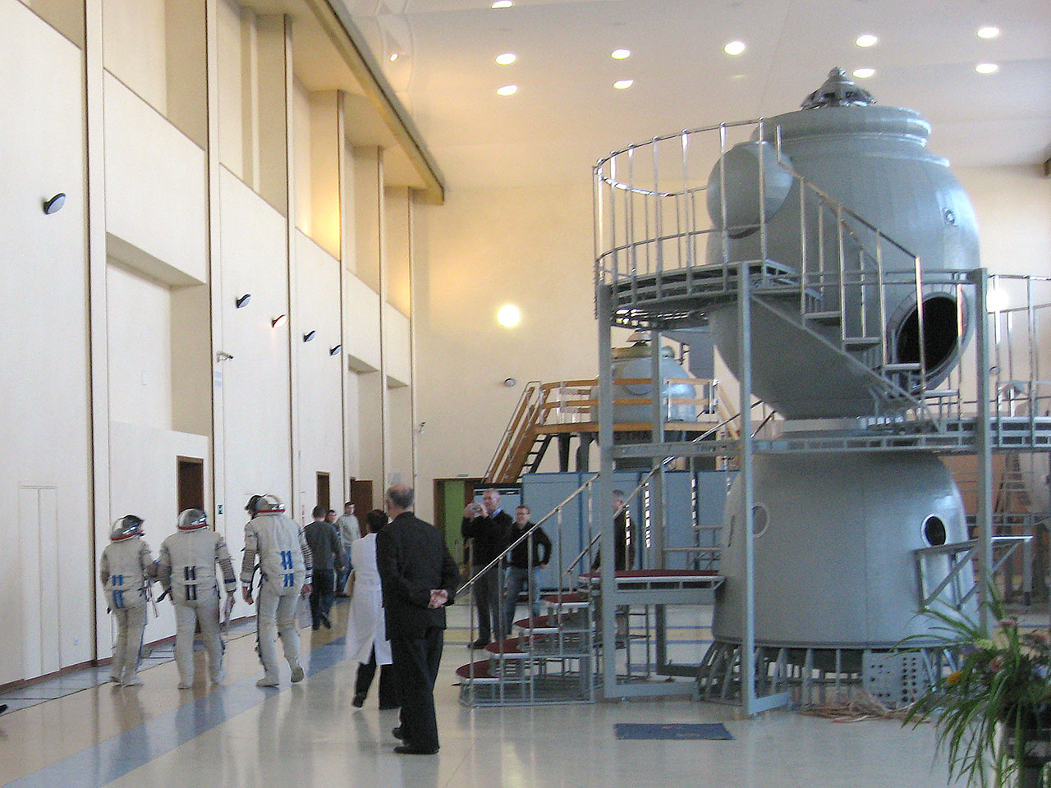
Virtual Reality :
SPACECRAFT SIMULATION
Currently our systems are used in two docking simulator trainers for the ISS, the main simulator and the simulator for pre-launch training.
www.softlab-nsk.com

Slide 9
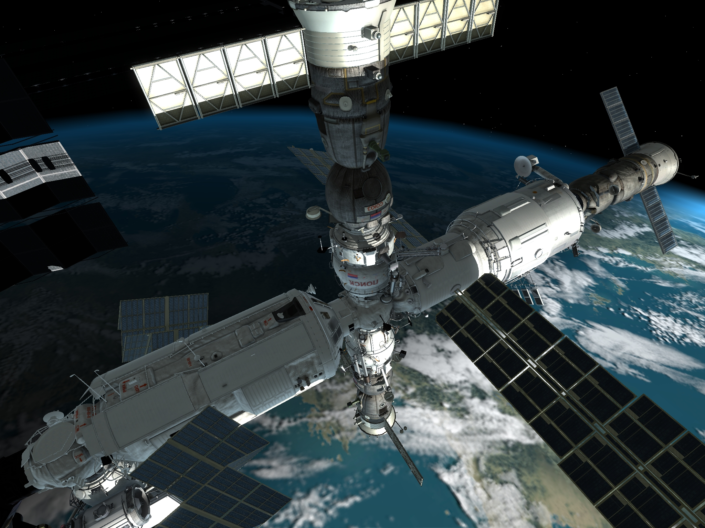

Slide 10
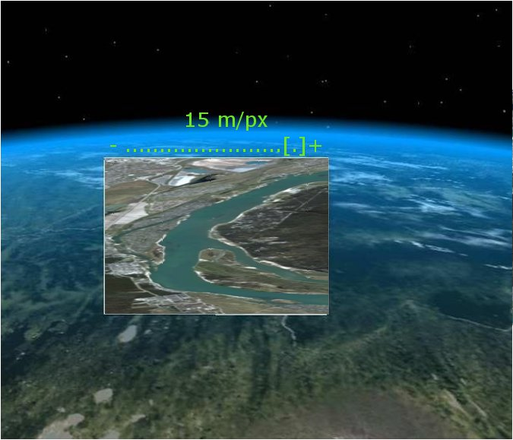

Slide 11
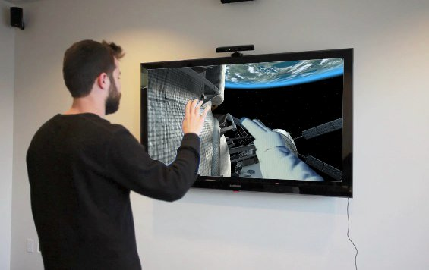

Slide 12
Virtual Reality :
RAILWAY SIMULATION
In 1997 we began development of simulator trainers for railway train sorting operators.
We developed, manufactured and installed six different and unique trainer complexes for classification yards, Inskaya-I, Inskaya-II, Vhodnaya, Novokuznetsk-Vostochny, Krasnoyarsk-Vostochny among them.
www.softlab-nsk.com

Slide 13
Virtual Reality :
RAILWAY SIMULATION
The trainer complex simulates the real work process of train sorting operators routing and braking the railway cars, and enables interaction between them.
The complex includes a multichannel image generator, railway car dynamics subsystem, non-nominal situation simulation subsystem and a real train sorting control desk.
A virtual railway station (Novosibirsk-Vostochny), similar to a train classification yard simulator, but aimed at large passenger railway station simulation, has been designed for the Siberian Transport University to use in education process.
www.softlab-nsk.com

Slide 14
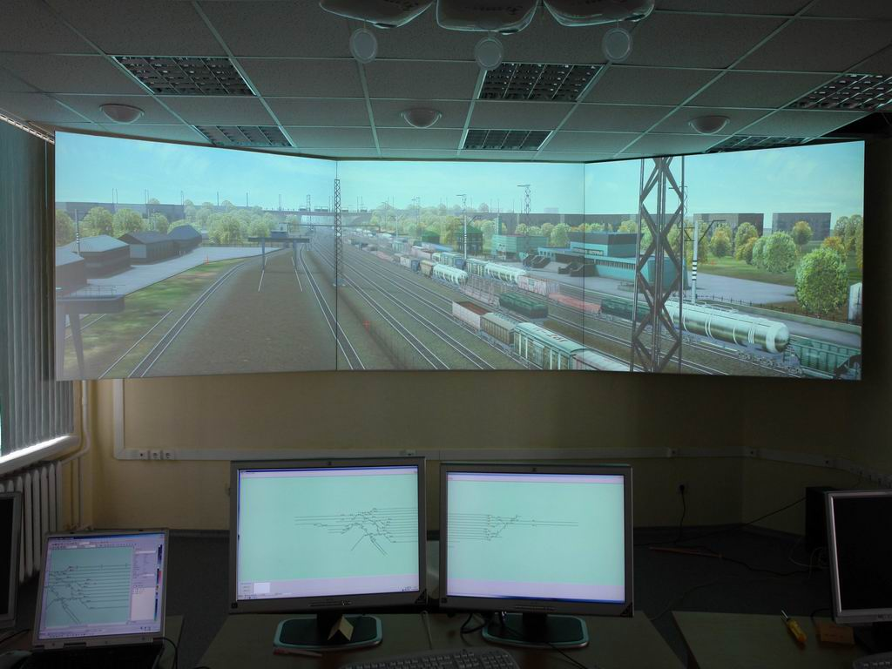

Slide 15
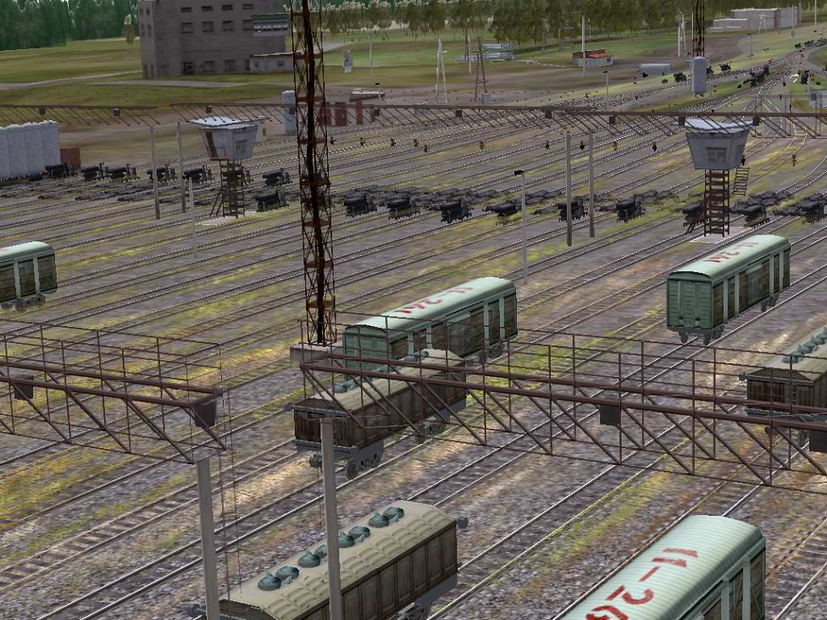

Slide 16
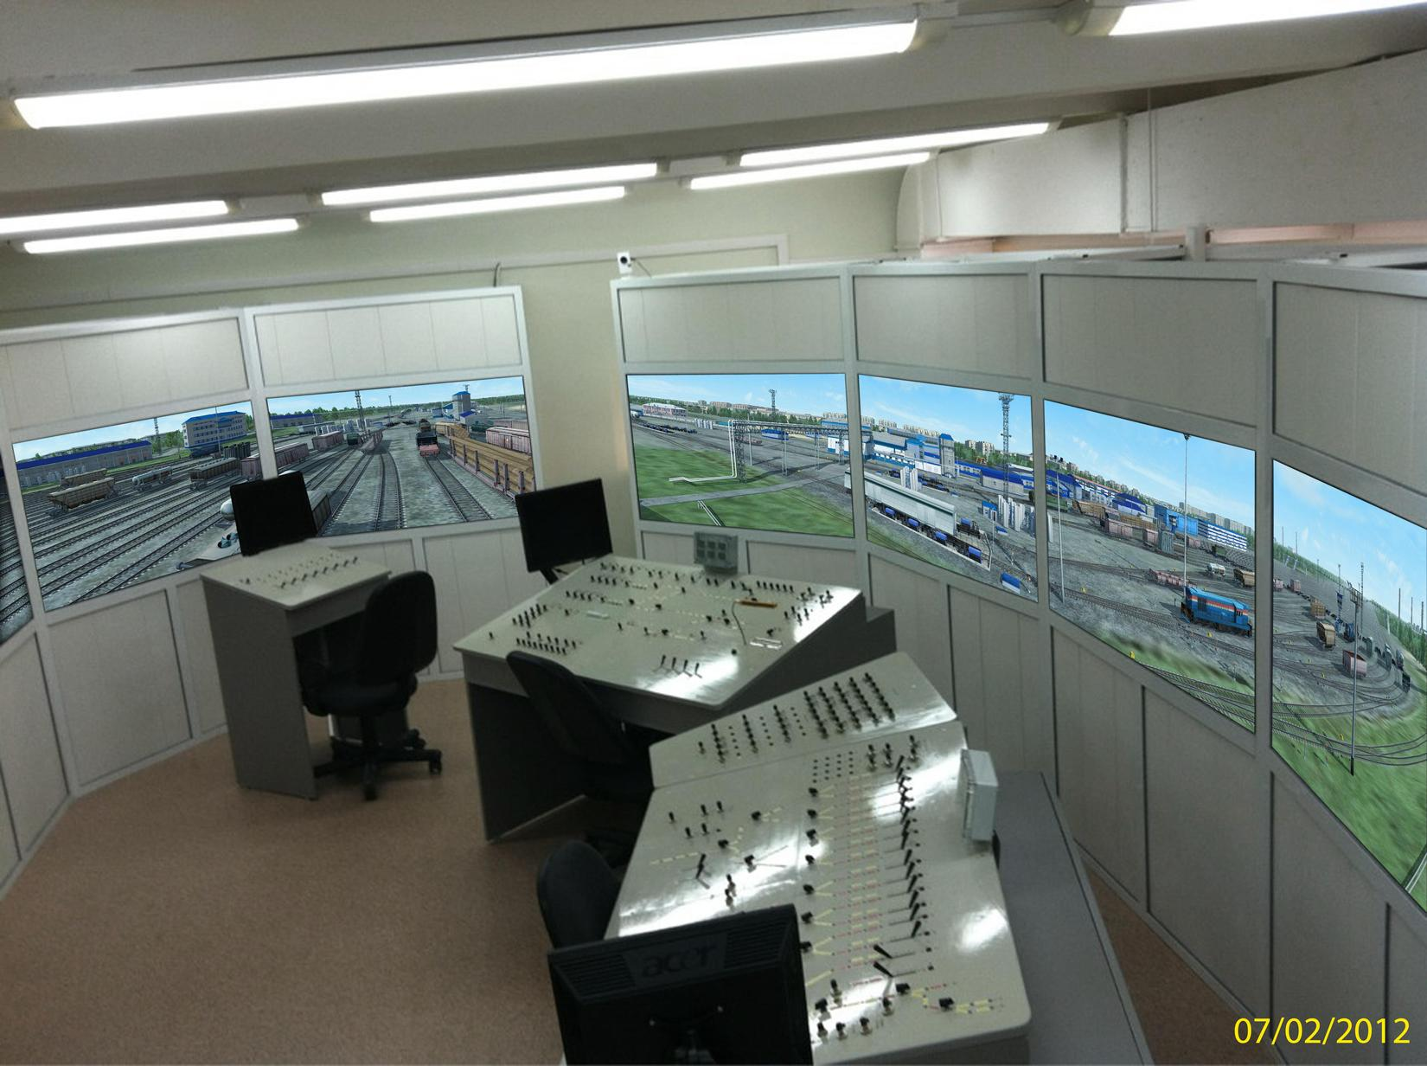

Slide 17
Virtual Reality :
COMPUTER GAMES
The game development at SoftLab-NSK started in 1995. The first games were made for The Other 90% Technologies, a US company, and supported MindDrive technology.
SoftLab-NSK became known as the developer of Hard Truck I, Hard Truck II (King Of The Road) computer games. Hard Truck II is one of THE TOP 100 PC GAMES OF THE 21ST CENTURY, according to Next-gen.biz. We were the only Russian team in that list.
www.rignroll.com

Slide 18
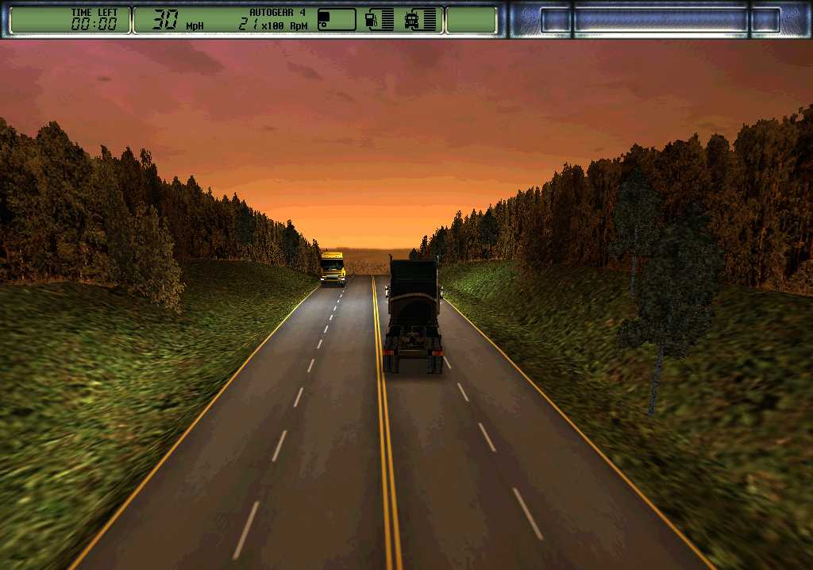

Slide 19
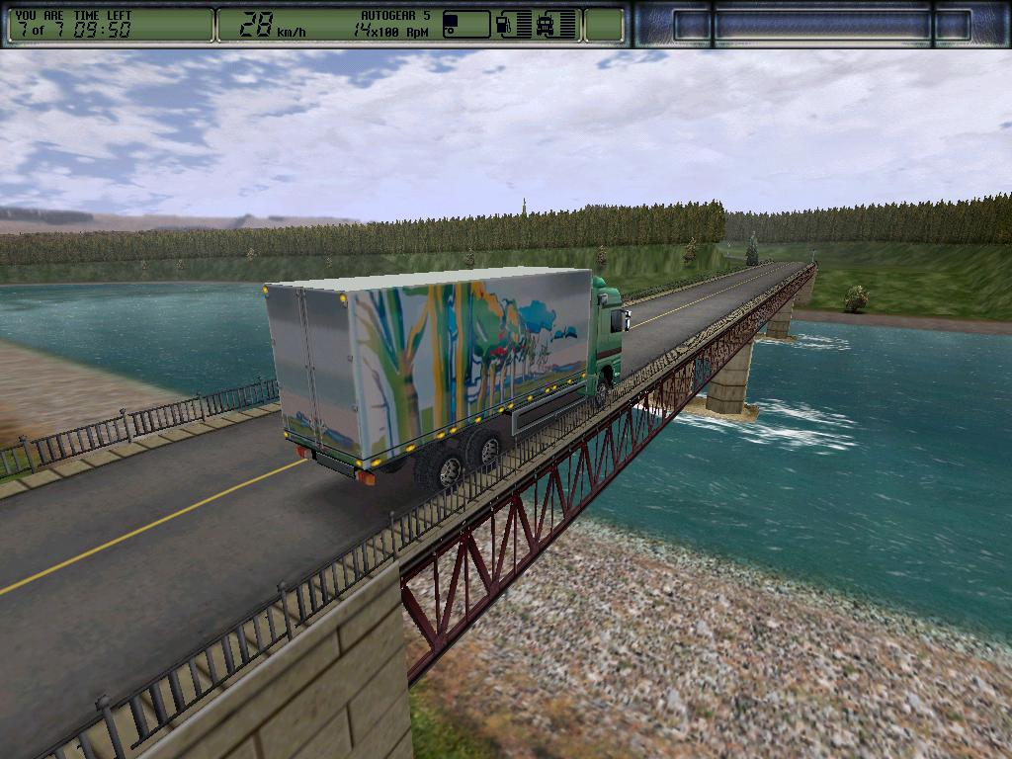

Slide 20
Virtual Reality :
COMPUTER GAMES
Hard Truck II has been sold in more than 2,000,000 copies worldwide, and for several months after the release stayed in the top 20 selling computer entertainment software titles in America (according to NPD TRSTS REPORTS)
The sales still go on.
www.rignroll.com
Notes:
20

Slide 22
Virtual Reality :
COMPUTER GAMES
In Q4 2009 the sequel was released. The title is «Дальнобойщики 3» for the Russian market and “Rig’n’Roll” for US market.
There are more than 2000 kilometers of California roads in the game. The game is a combination of truck racing, simulation and economic strategy.
The US and European releases are scheduled for Q3 2010.
www.rignroll.com
Notes:
22

Slide 23
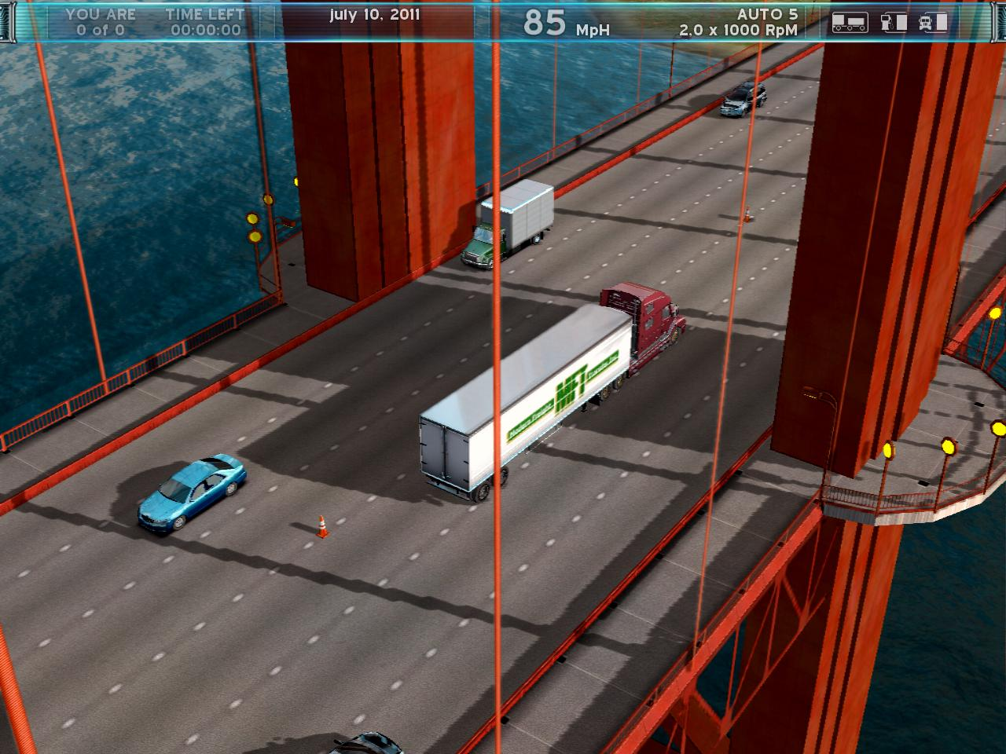

Slide 24
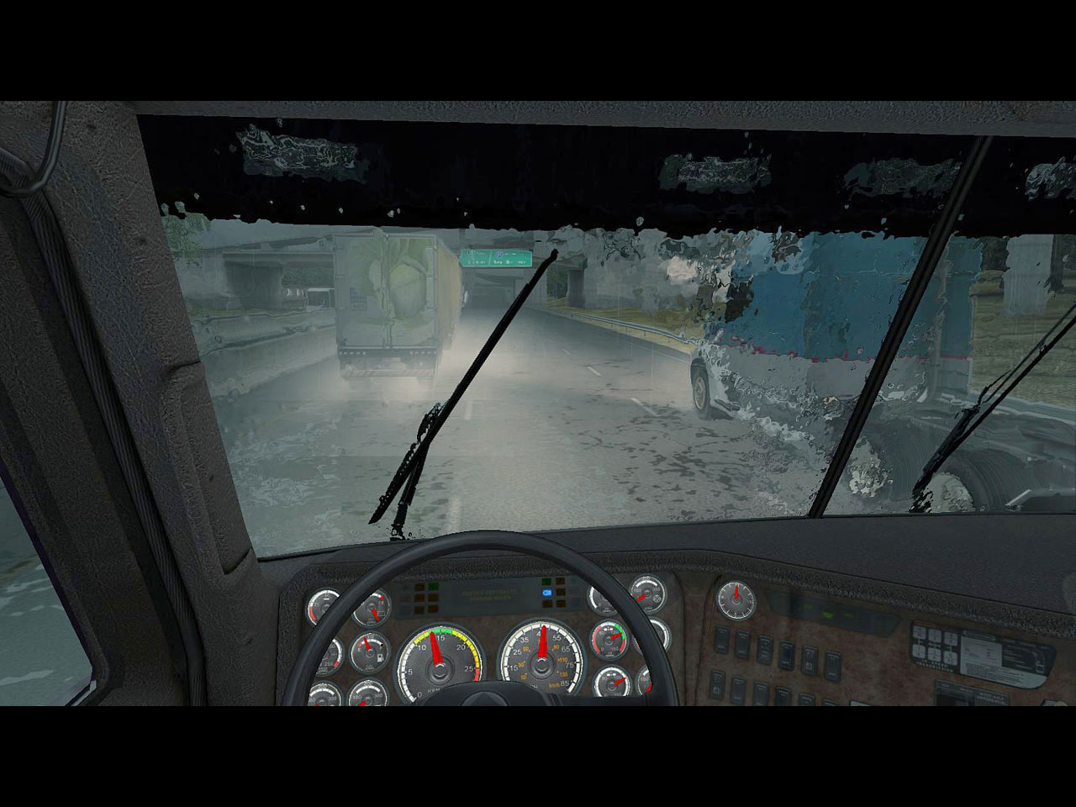

Slide 25
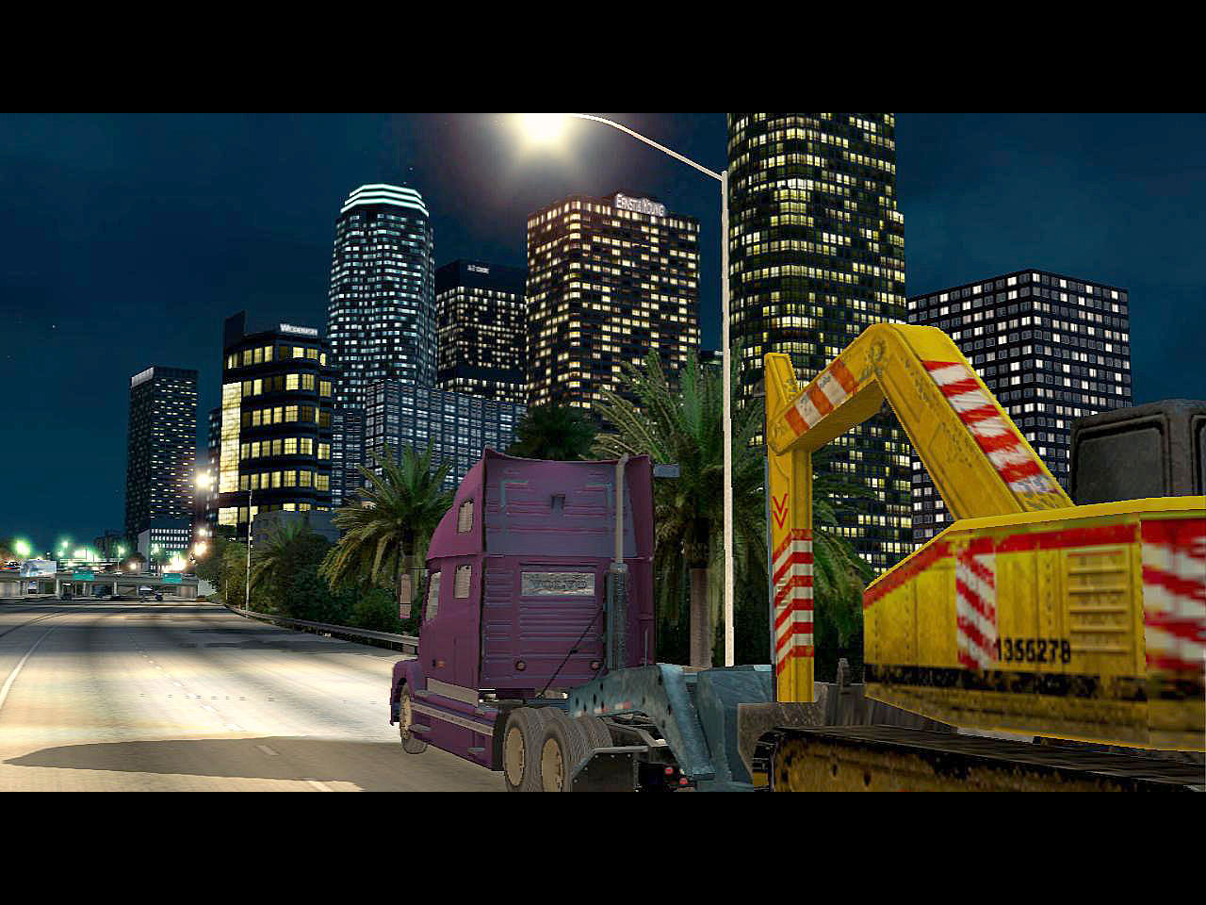

Slide 26
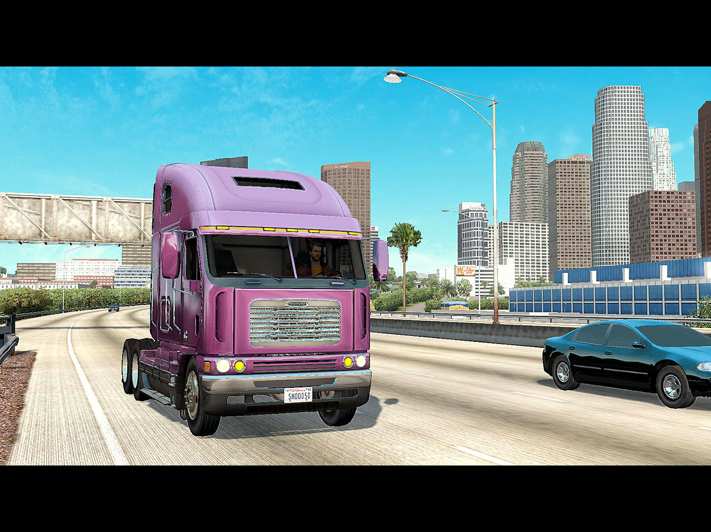

Slide 27
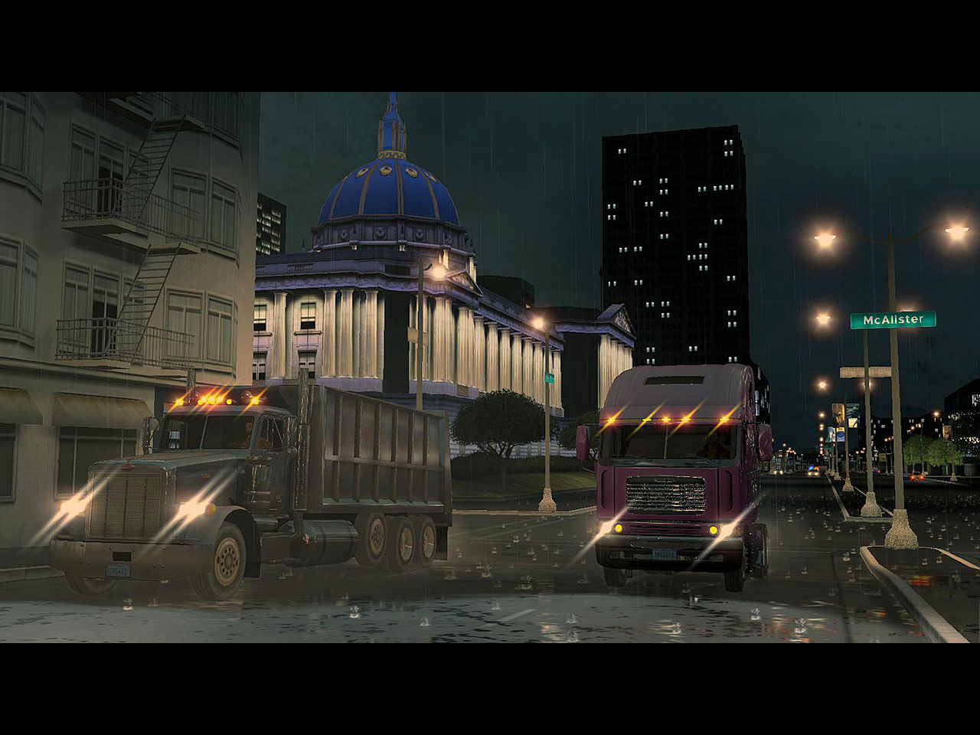

Slide 28
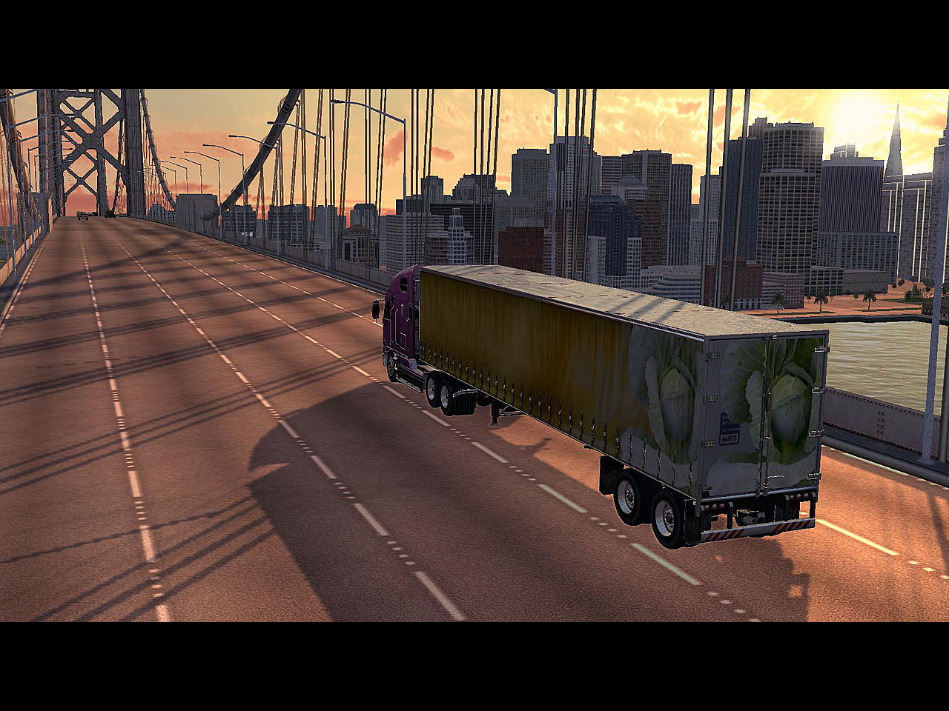

Slide 29
Virtual Reality:
Games for mobile phones. “Drive a Ball“
www.softlab-nsk.com
Notes:
29

Slide 30
Virtual Reality :
E-learning & Virtual Communications
We develop VR-based distance education and online communication systems, to enable geographically distant users - tutors, students, corporate staff, to attend the classes in virtual environment, thus taking distant education to a whole new level where it approaches the traditional education in quality.
www.softlab-nsk.com
Notes:
30

Slide 31
Virtual Reality :
E-learning & Virtual Communications
The participants of a virtual meeting are represented by their custom 3D avatars and are able to move, converse with each other, gesticulate and interact with objects in the virtual world.
www.softlab-nsk.com
Notes:
31

Slide 32
Virtual Reality :
E-learning & Virtual Communications
www.softlab-nsk.com
Notes:
32

Slide 33
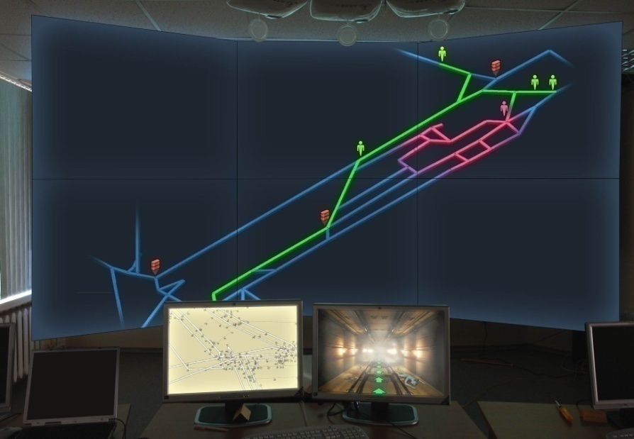
Virtual Reality
We are looking for business partners and customers in the following areas:
1. Simulator trainers
a) Trainers for ground transportation
b) Trainers for special or rescue missions in potentially hazardous/dangerous industrial environments.
c) Situational trainers for experts making decisions based on analysis of 3D information.
www.softlab-nsk.com

Slide 34
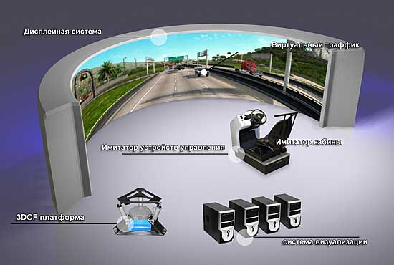
Virtual Reality
2. VR-based presentation or entertainment centers, information, education systems ( virtual museums, parks, large city traffic simulations, 3D assembly charts etc.)
3. Computer games of different genres and for different platforms
(PC, mobile, online, social … )
www.softlab-nsk.com

Slide 35
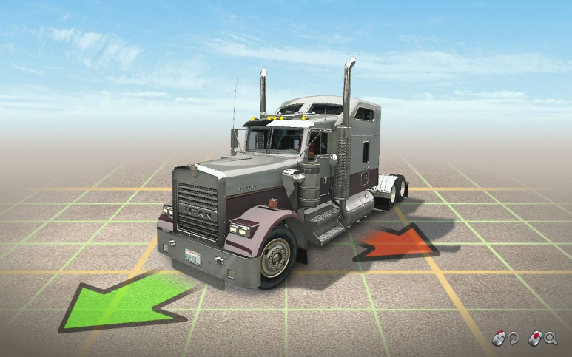
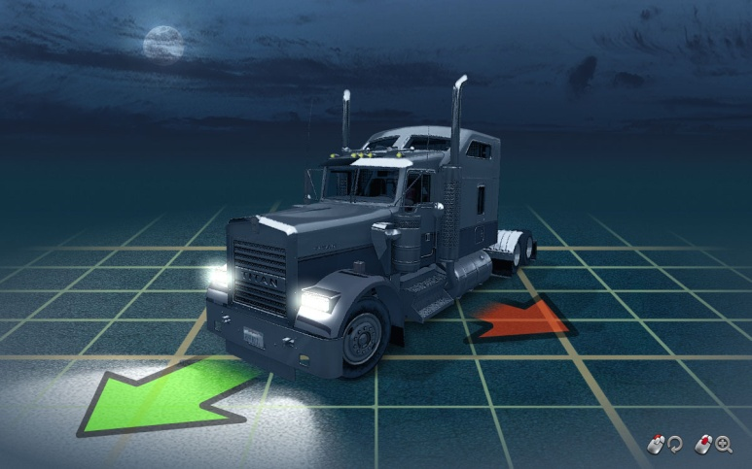
Virtual Reality
4. Road safety:
Traffic prediction and control,
- Vehicle monitoring,
- Vehicle attitude logging and analysis,
- Detection of dangerous or inadequate driving.
www.softlab-nsk.com

Slide 36
JSC "SoftLab-NSK"
Michael Schadrin,
Head of Multimedia department mikesha@sl.iae.nsk.su www.softlab-nsk.com
www.softlab-nsk.com
Notes:
36

Slide 37
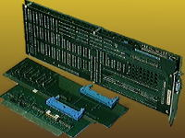
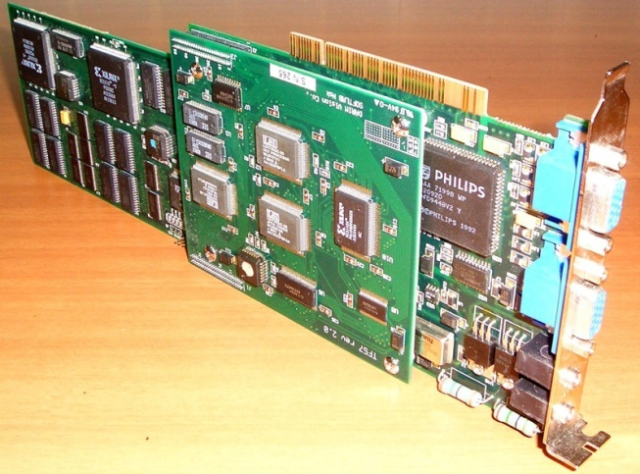
Multimedia
1991 – first realtime video playback system
1993 - professional video playback system “Phoenix”
1998 – started mass-production of “Forward” system
37
Notes:
Our work in multimedia started with developing algorithms and devices for video decompression :
1991 – created the country’s first real-time system for the decompression of generated images.
1993 – created a professional system for real-time video decompression named “Phoenix”.
The systems were widely replicated and distributed to many state and proprietary large and medium-sized TV studios from Yakutsk to St Petersburg. This project not only payed itself but also enabled the next project –Forward.
37

Slide 38
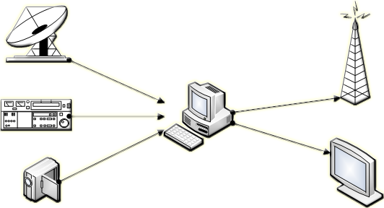
Multimedia
Broadcast TV
Broadcast Server
Forward
Live Inputs
Preview
38
Notes:
The Forward project has been developing for already 15 years.
For this time, a rich experience has been stored in dealing with various broadcasters and rebroadcasters of CIS countries – from large state companies to small proprietary companies, over-the-air, cable companies, and even IPTV.
This experience crystallized in software & hardware systems that allow to perform all the range of the broadcast tasks.
38

Slide 39
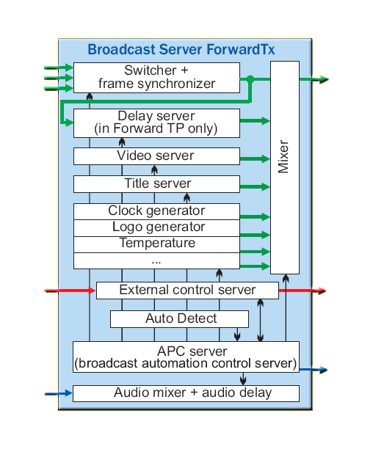
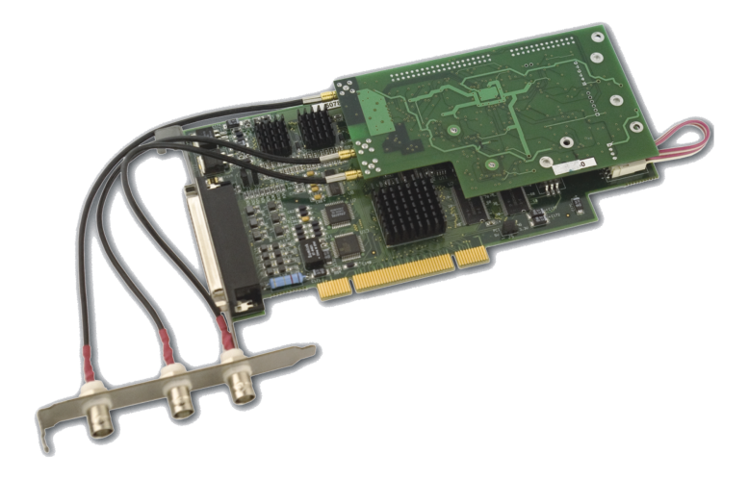
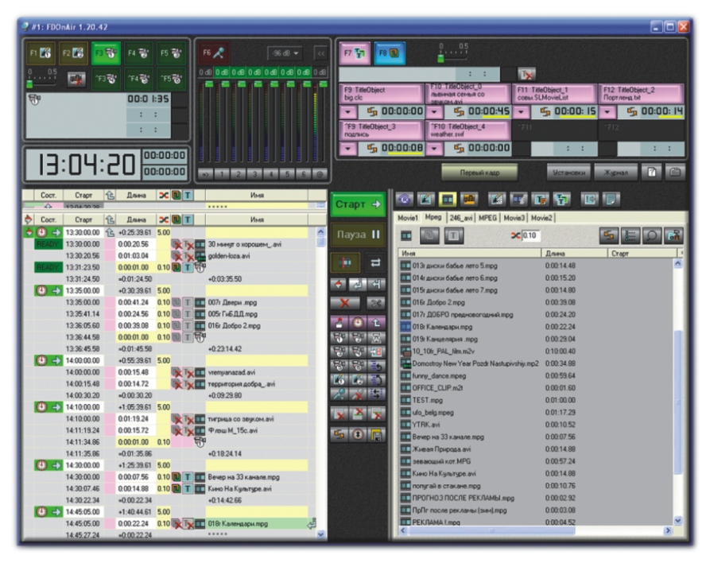
Multimedia
Video
Inputs
Video Outputs
GPI
Inputs
GPI
Outputs
Audio
Outputs
Audio
Inputs
Notes:
We offer all-in-one solutions when one system realizes all the desired functionality.
In time, the larger part of functionality has been shifted from hardware to mostly software solutions, which allows us and our clients to easily switch to digital TV.
All the technologies of broadcast production acquired by our clients remain unchanged. Most part of the programs remain unchanged. The only thing what changes is hardware.
39

Slide 40
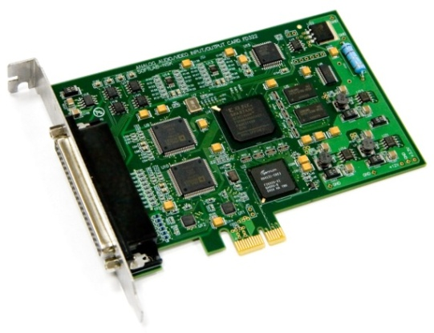
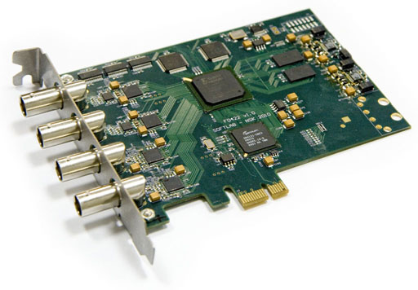
Multimedia
Notes:
Now we support whole range of standard TV platforms (Analog, SD-SDI, HD-SDI, HDMI) and main IP-streaming platforms (UDP/RTP unicast/multicast, RTSP, HTTP Live Streaming).
We support FEC for IP-streaming (ProMPEG).
40

Slide 41
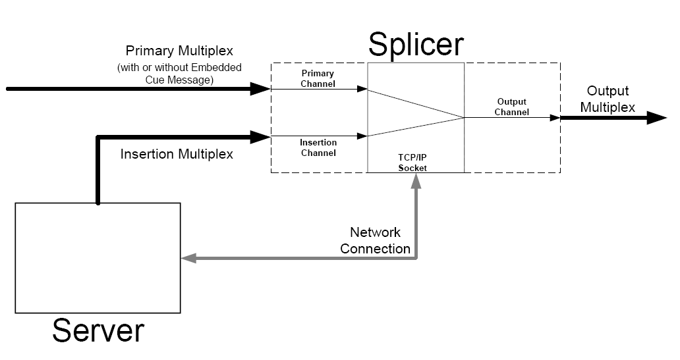
Multimedia
SCTE 30/35
Notes:
We are developing a real revolutionary approach to ad insertion and adding overlays to digital TV.
This approach absolutely differs from SCTE 30/35 standards that are used in the USA, CLICK since these standards are absolutely nonviable in Russian conditions.
41

Slide 42
Multimedia
Forward TS
Video/ Audio Decoder
Mixer
Video/ Audio Encoder
TS
Demux
Muxer
TS
Existing software
Notes:
This technology is much more flexible than SCTE standards. It implies using partial recompression, and we actively cooperate with the MainConcept and Elecard companies in the enhancement of the partial recompression algorithms.
42

Slide 43
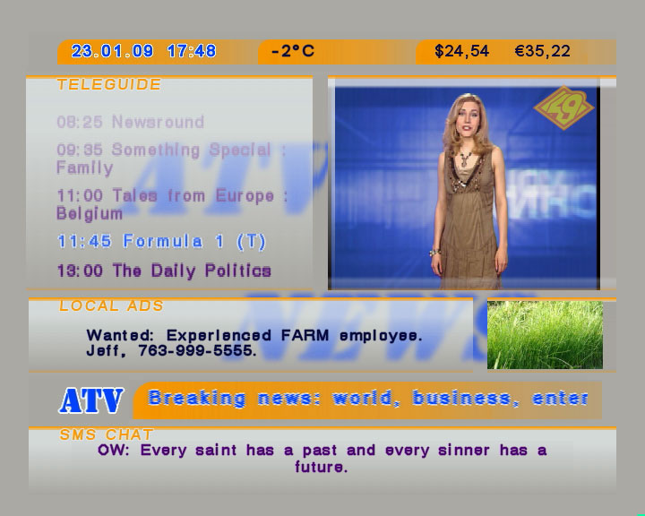
Multimedia
Support for Weather Stations
Telephone Polls
Local Date & Time
SMS chat
RSS feed
Weather, text or picture from Web
Notes:
And now a little switch to other aspects of multimedia.
Currently, we are actively developing software tools for automatic content generation:
to collect news from RSS sites, to arrange telephone polls, provide SMS chats, display current time info, display information from local text or graphics files.
We support different weather stations and collect weather data from web sites.
43

Slide 44
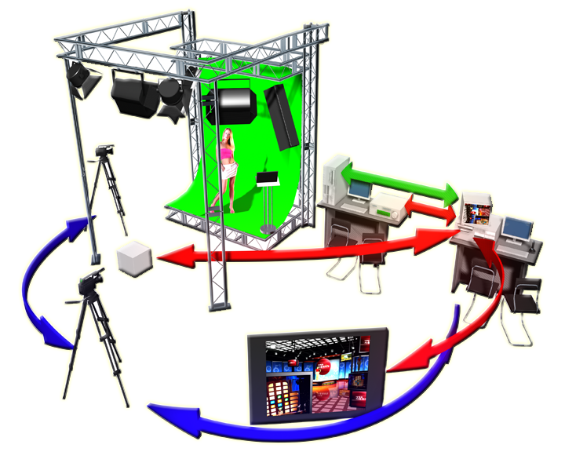
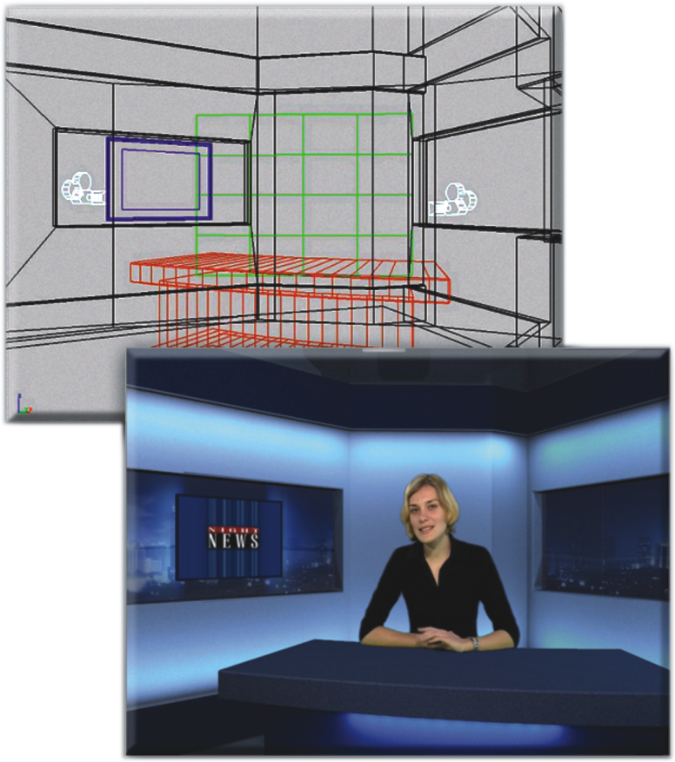
Multimedia
44
Notes:
Focus Lite – You are All Set to Start Shooting Right Now! Simple setup, common design tools.
44

Slide 45
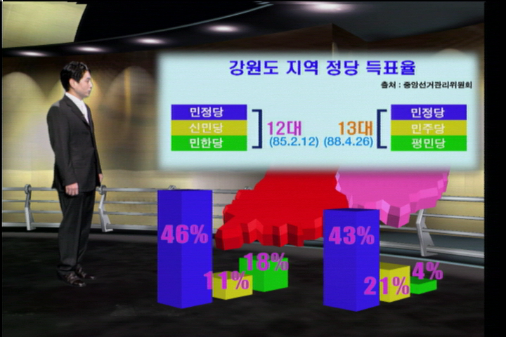
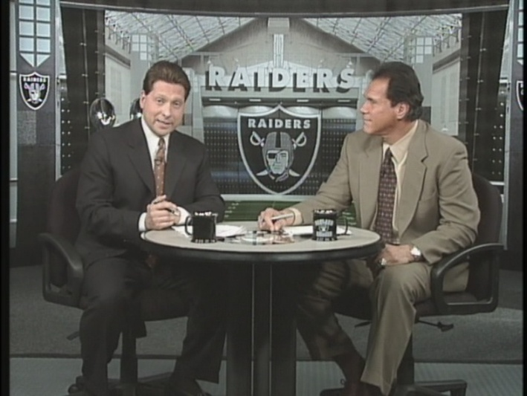
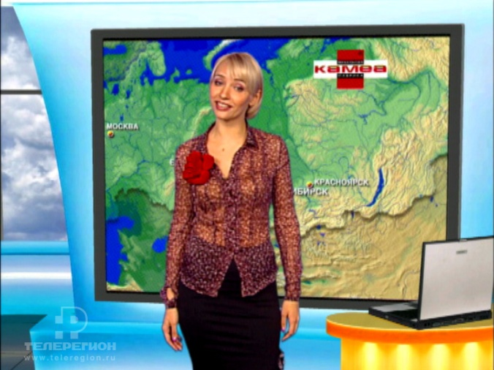
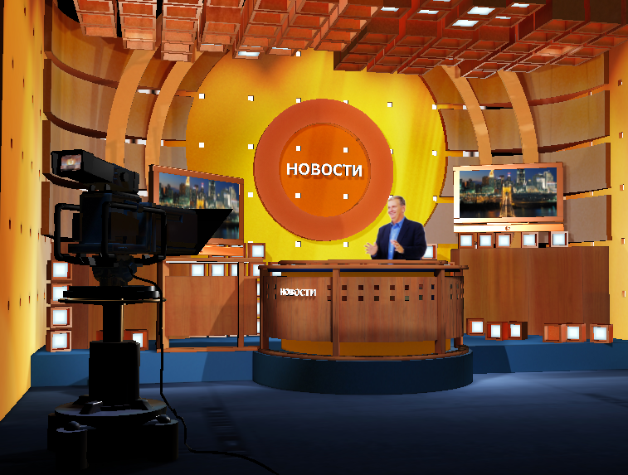
Multimedia
Virtual Studio “Focus” – basis for low-budget interactive TV production
45
Notes:
45

Slide 46
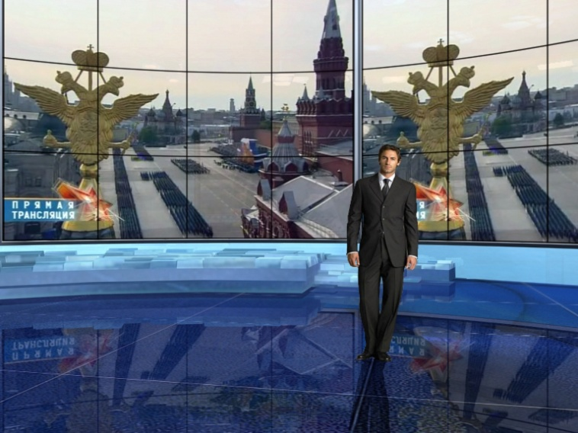
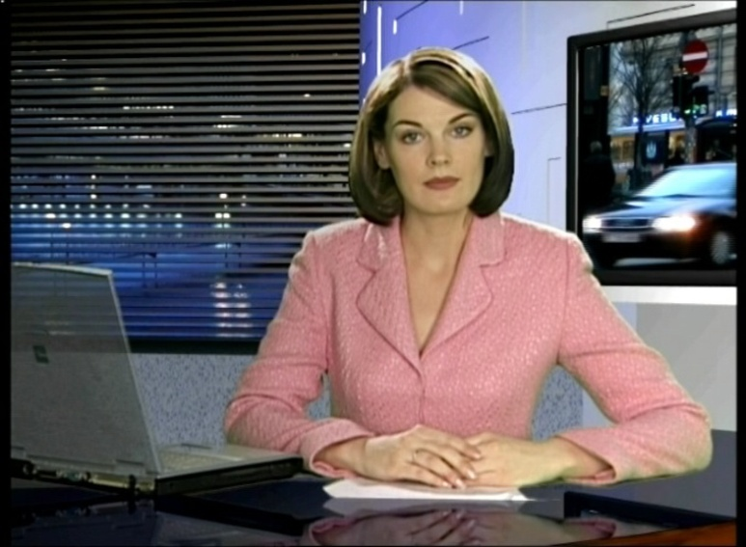
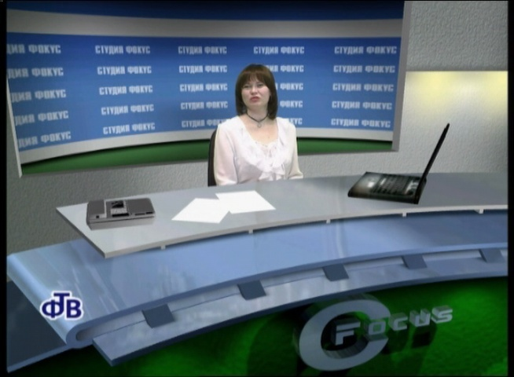
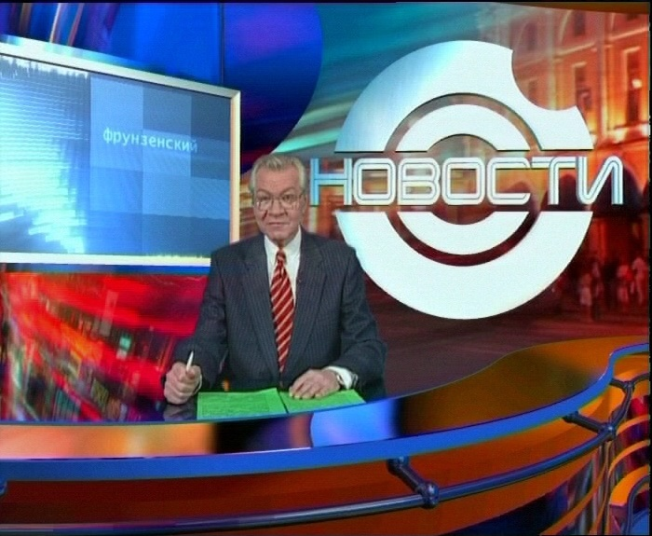
Multimedia
$10K
looks like
$1000K!
46
Notes:
Check it out! Our $10K “Focus” has a similar-quality output as of well-known top-expensive $1000K systems
46

Slide 47
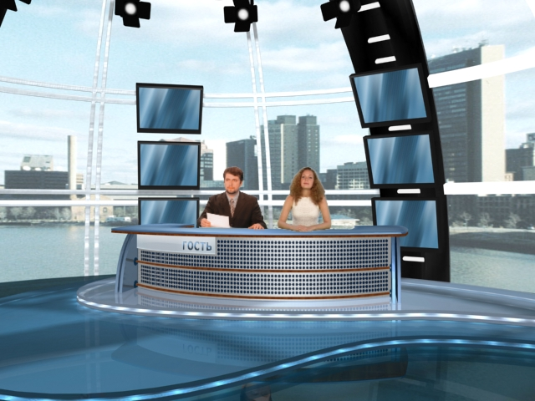
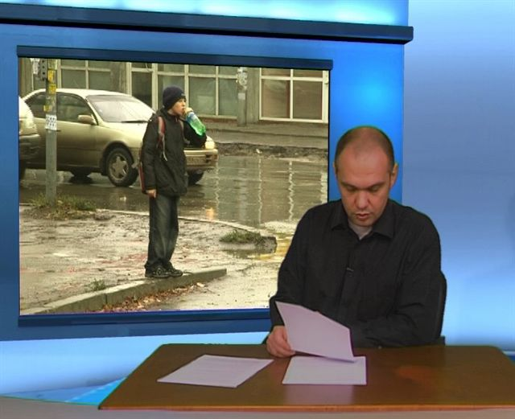
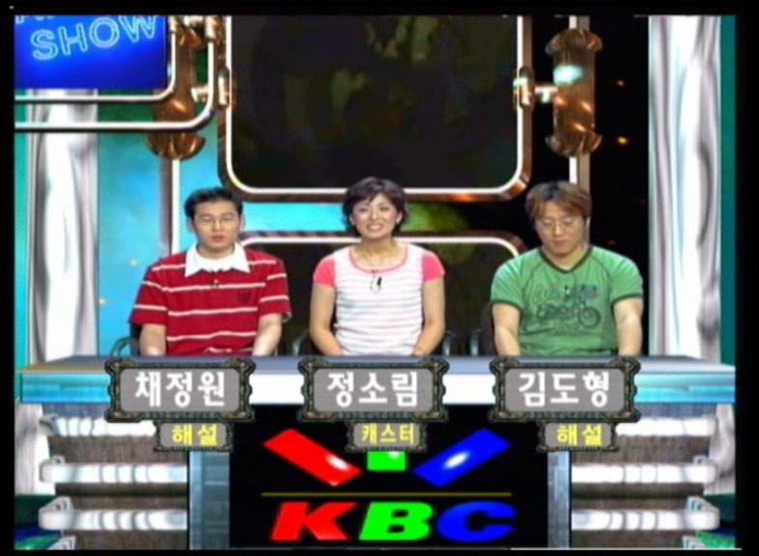
Multimedia
“Focus” – unique and recognizable production at the same time…
47
Notes:
Focus – Any Custom Studio to Please Yourself!
47

Slide 48
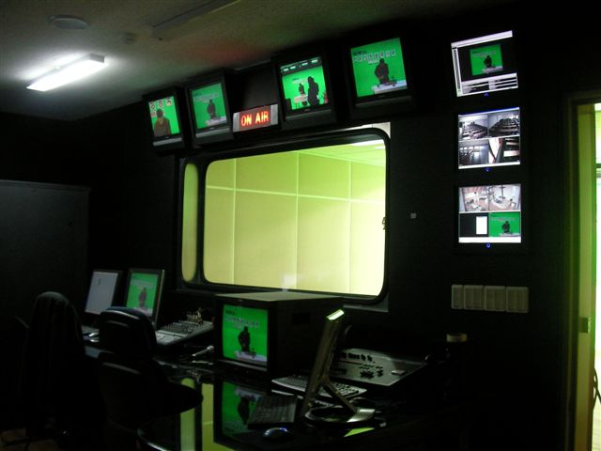
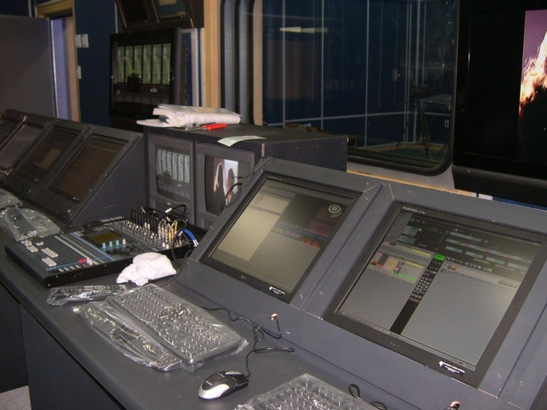
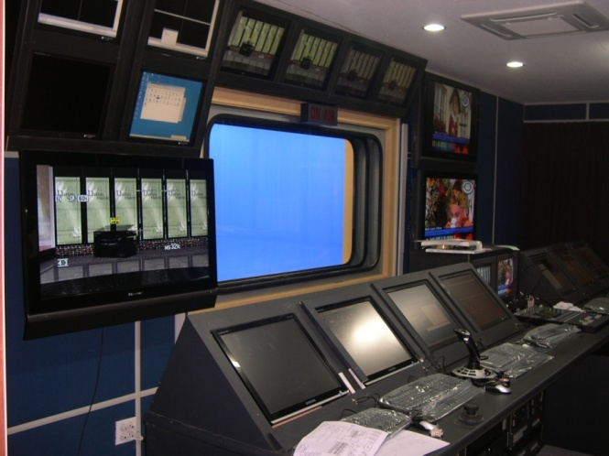
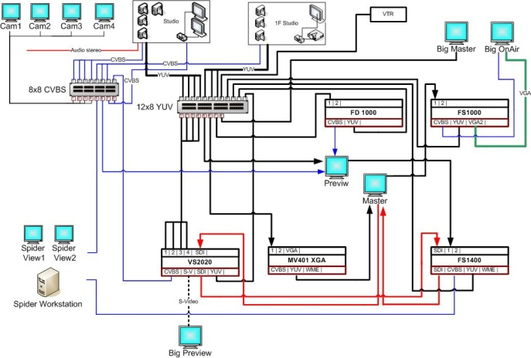
Multimedia
We produce full set of computer components for integrated solutions for IPTV, Cable and other studios
48
Notes:
48

Slide 49
Multimedia
Our customers are regional TV broadcasters, internet providers, cable TV providers.
More than 70% of Russian TV broadcasting companies chose our solutions.
Since 2009 we have started selling our production all over the world.
Our distributors actively work in eastern Europe (Serbia, Rumania, Montenegro), Argentina, China. Our customers are in Canada, Austria, South Africa.
49
Notes:
Our customers are regional TV broadcasters, internet providers, cable TV providers.
More than 50% of Russian TV broadcasting companies chose our solutions.
Since 2009 we have started selling our production all over the world.
Our distributors actively work in eastern Europe (Serbia, Rumania, Montenegro, Argentina, China). Our customers are in Canada, Austria, South Africa.
49

Slide 50
Multimedia
Multimedia Department Concept
Working for wide low-budget market
Cost-effective solutions should match typical budget of target customers
Almost the same functionality as of the topmost systems should be available
Results should look as top-professional
Unique smart technology and algorithms
50
Notes:
…
We are dragging oneselfs by the hair out of the swamp
50

Slide 51
JSC "SoftLab-NSK"
Contacts
Fax: +7 (383) 333-21-73
Phone: +7 (383) 33-99-220, 333-10-67
Email: administration@softlab-nsk.com
WWW: htpp://www.softlab-nsk.com/
Postal address:
SoftLab-NSK
Koptuga pr-t, 1
Novosibirsk
630090, RUSSIA
www.softlab-nsk.com

